Slide 1


Global Risk
Management System
(GRMS)
Report Month - June
Confidential

Slide 2
GRMS
Project Objective:
The scope of our review was designed to identify and test key control mechanisms within ENA’s GRMS applications in accordance with the 2000 Business Audit Plan. Our audit procedures included interviews with key ENA personnel, review and assessment of available policy and procedure documentation and appropriate levels of testing necessary to identify strengths and weaknesses related to the existing control environment.
AA Team Members: Enron Team Members:
Tom Bauer Beth Perlman
Ed Hill Andrew Parsons
Michael Schultz Mike Moscoso
Cindy Davis Gary Stadler
Russ Bouwhuis Ganapathy Ramesh
Sean Sipko

Slide 3
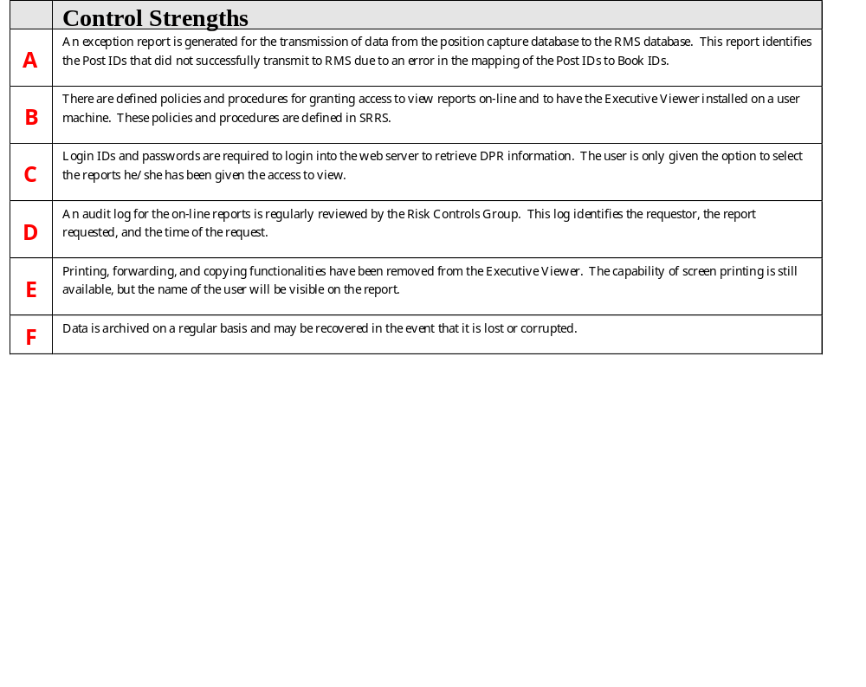
GRMS Observations

Slide 4
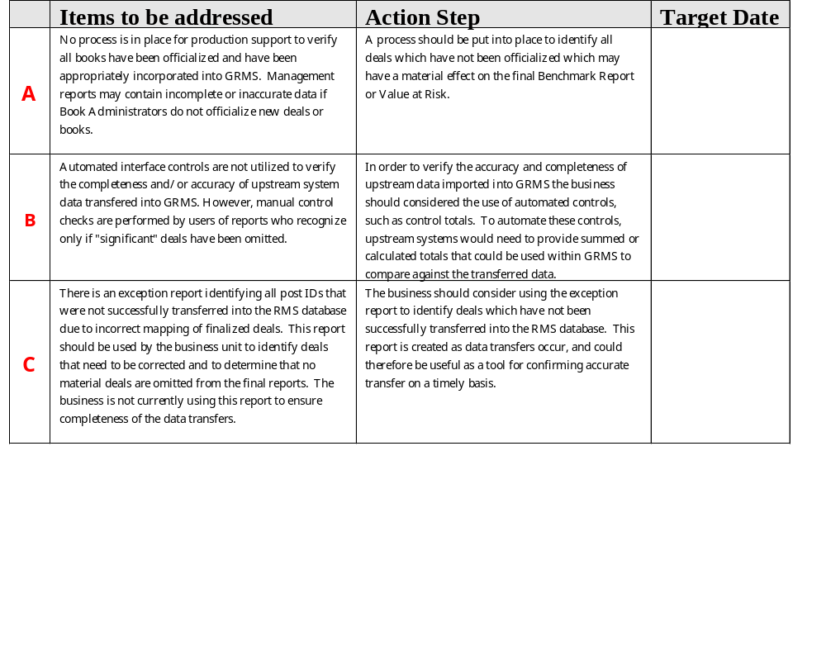
GRMS Observations

Slide 5
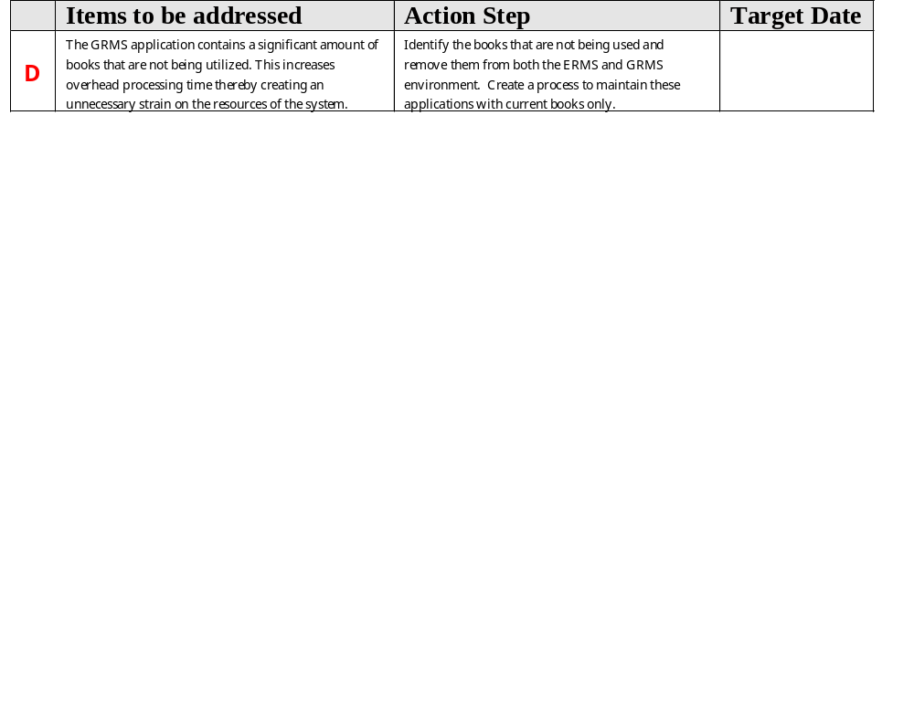
GRMS Observations

Slide 6
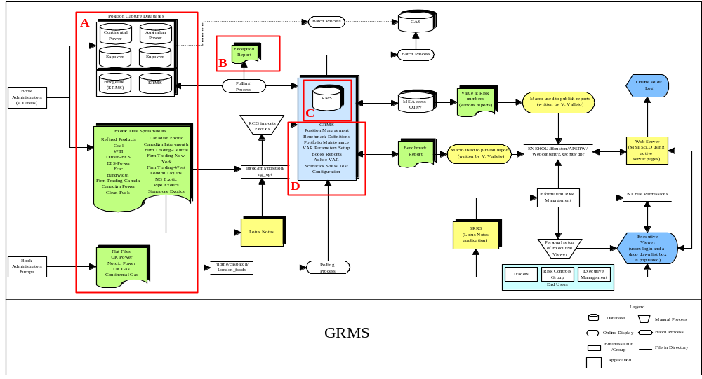
GRMS

